Slide 1
SPM FINAL PRESENTATION
G1T8 - LET'S GIT IT
HILYA SYAZWANI
LIM HUI SIN
LIM JIE MIN
TAN XIN RONG STEFFI
KU SEOUNGLIM (SKY)

Slide 2


Overview
Schedule
Actual Versus Planned Schedule
Functionality
Breakdown Of Work
Problems Faced
Bug Metric
Visual Representation
Actions Taken
Challenges Faced
Use Of Git
Main Takeaways
G1T8 - Let’s git it!
Team conflicts / issues / problems
Interesting Facts

Slide 3
Schedule

Slide 4

Planned Schedule
Milestone 4: Project Submission
Milestone 5: Final Presentation
Milestone 1: PM Review
Milestone 2: Online Review
Milestone 3: UAT
1
2
3
4
5
Iter 1: 19 Sept
Complete login + bootstrap
Iter 2: 3 Oct
Complete all other UI functionalities and round clearing logic
Iter 3: 17 Oct
Complete web service
Iter 4: 31 Oct
Post-UAT testing and debugging
Iter 5: 14 Nov
Preparation for Final Presentation
Notes:
Schedule (Do not show us your MS Project file)
Visual representation of Actual Versus Planned Schedule in 2 or less readable slides. A timeline representation is sufficient here.
Did you drop any functionalities, implement any additional functionalities, and/or use any frameworks or external libraries? If so what.
Show us your breakdown of work. Separate the programming tasks from the non-programming tasks. For programming tasks, show us the task allocation as well as the hours spent by each team member. Explain why your work allocation was fair. Show us absolute numbers as well as percentages.
Tell us about the problems you faced tracking your schedule and how you overcame them.

Slide 5
Actual Schedule
Milestone 4: Project Submission
Milestone 5: Final Presentation
Milestone 1: PM Review
Milestone 2: Online Review
Milestone 3: UAT
1
2
3
4
5
Iter 1: 19 Sept
Completed login
Iter 2: 3 Oct
Completed all other UI functionalities
Iter 3: 17 Oct
Completed round clearing logic and all web service APIs except bid-status
Iter 4: 31 Oct
Post-UAT testing and debugging, writing of JSON test cases
Iter 5: 14 Nov
Final testing and debugging, preparation for Final Presentation
Notes:
Schedule (Do not show us your MS Project file)
Visual representation of Actual Versus Planned Schedule in 2 or less readable slides. A timeline representation is sufficient here.
Did you drop any functionalities, implement any additional functionalities, and/or use any frameworks or external libraries? If so what.
Show us your breakdown of work. Separate the programming tasks from the non-programming tasks. For programming tasks, show us the task allocation as well as the hours spent by each team member. Explain why your work allocation was fair. Show us absolute numbers as well as percentages.
Tell us about the problems you faced tracking your schedule and how you overcame them.

Slide 6
Functionality
Did you drop any functionalities?
Our team did not drop any functionalities.
Did you implement any additional functionalities?
Our team did not implement any additional functionalities.
Did you use any framework or external libraries?
We did not use any framework or external libraries.

Slide 7

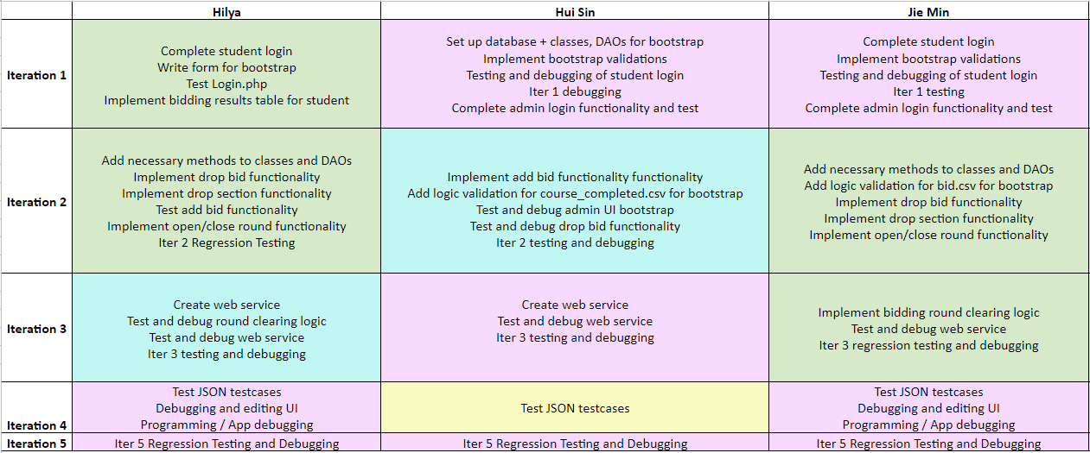
Breakdown Of Work
Notes:
Schedule (Do not show us your MS Project file)
Show us your breakdown of work. Separate the programming tasks from the non-programming tasks. For programming tasks, show us the task allocation as well as the hours spent by each team member. Explain why your work allocation was fair. Show us absolute numbers as well as percentages.

Slide 8
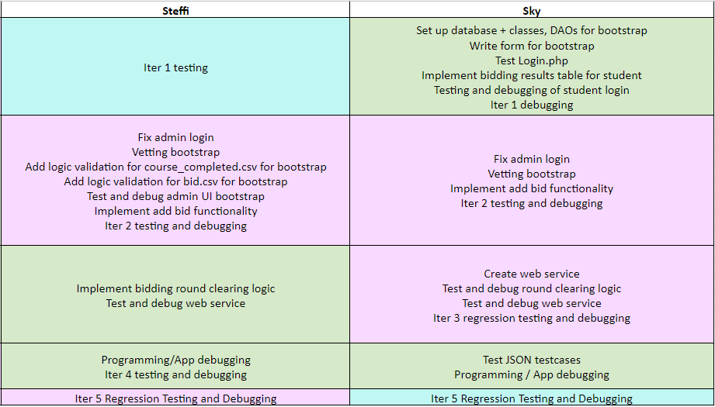
Breakdown Of Work
Notes:
Schedule (Do not show us your MS Project file)
Show us your breakdown of work. Separate the programming tasks from the non-programming tasks. For programming tasks, show us the task allocation as well as the hours spent by each team member. Explain why your work allocation was fair. Show us absolute numbers as well as percentages.

Slide 9
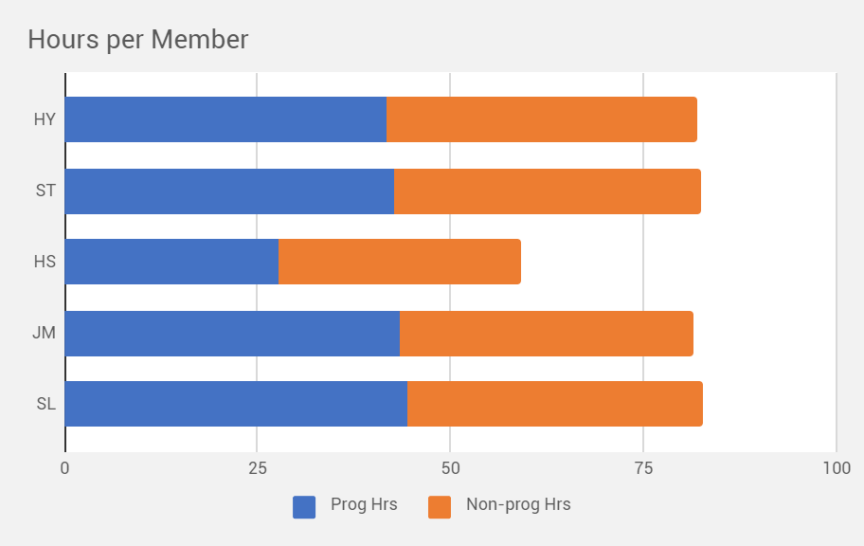
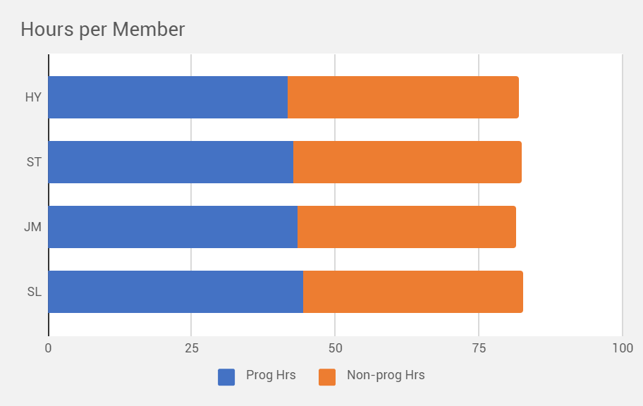
Hours per member
 | SL | JM | HS | ST | HY | Average | 10%
Prog Hrs | 44.43 | 43.43 | 27.77 | 42.78 | 41.68 | 40.02 | 4.00
Non-prog Hrs | 38.17 | 38.13 | 31.28 | 39.60 | 40.20 | 37.48 | 3.75
Prog Hrs (%) | 22.21 | 21.71 | 13.88 | 21.38 | 20.83
Non-prog Hrs (%) | 20.37 | 20.35 | 16.69 | 21.13 | 21.45
As can be seen from the graphs and the table, the number of both programming and non-programming hours are roughly equal, the exception being Hui Sin who was out of commission for 2 weeks due to chicken pox.

Slide 10

Breakdown Of Work
Non-Programming Tasks
Daily Update
Writing of Manual Test Cases
Writing of JSON Test Cases
Presentation Slides
Upload minutes
Notes:
Schedule (Do not show us your MS Project file)
Show us your breakdown of work. Separate the programming tasks from the non-programming tasks. For programming tasks, show us the task allocation as well as the hours spent by each team member. Explain why your work allocation was fair. Show us absolute numbers as well as percentages.

Slide 11
Problems Faced
Challenges | Actions Taken
Estimating task duration - We underestimated how long a task will take for us to complete resulting in a schedule that reflects only a best-case scenario. | We ensured that our planned duration included sufficient buffer time to complete the PP task. We also planned our PP sessions such that we could work overtime if necessary.
Setting implementation date - Despite laying out a plan, it was difficult to follow it closely due to unforeseen events / conflicts in personal schedules. | We had to proactively communicate with each other and the PM to reschedule our PP sessions.
Managing change - Because of the changes and updates on project requirements, there were changes to project schedule | Communication on Telegram was important to ensure that everyone had the same understanding of the requirements, in order to agree to schedule changes to accommodate every member
Notes:
Schedule (Do not show us your MS Project file)
Tell us about the problems you faced tracking your schedule and how you overcame them

Slide 12
Bug Metric

Slide 13
Bug Metric
Iteration No. | Final Bug Metric
Iter. 1 | 26
Iter. 2 | 156
Iter. 3 | 142
Iter. 4 | 321
Iter. 5 | 270
Notes:
Bug Metric
Show us a visual representation for the metric that shows the values of the metric over time.
Tell us how you used the metric to fix problems identified.

Slide 14
Actions Taken
Whenever we encounter critical bugs, we always follow the instructions on bug metric. We stop immediately and get the PM to arrange a PP session to debug, or arrange a PP session and let the PM know later.
Usually, we combine testing and debugging together into one task. Testing is mostly done in pairs, and this allows us to stop testing to debug the code if we encounter any critical bugs.
Notes:
Bug Metric
Give us examples of concrete follow-on actions you took to fix the most severe problems identified by the metric.

Slide 15
Challenges Faced
Challenges | Actions Taken
Improper bug logging process - bug is not properly reported hence, missing of few required fields, incorrect description etc. | We had a short meeting with all groupmates to establish ground rules on the bug metrics. It was to ensure everyone was on the same page on how to record, what to record, when to record, the bugs.
Not logging in defect, even after communication - Team will follow their own communication channel to communicate defects using Telegram. Sometimes members don’t or forgot to log defect after communicating the issues | We ensured that during each iteration, just like how we have a PM, we have our own designated member who will collate all bugs before committing and pushing them. This is to ensure that logging of bugs is kept tidy and consistent.
Notes:
What were some of the challenges faced (and how you overcame them) when collecting and using the metric?

Slide 16
Use of Git

Slide 17
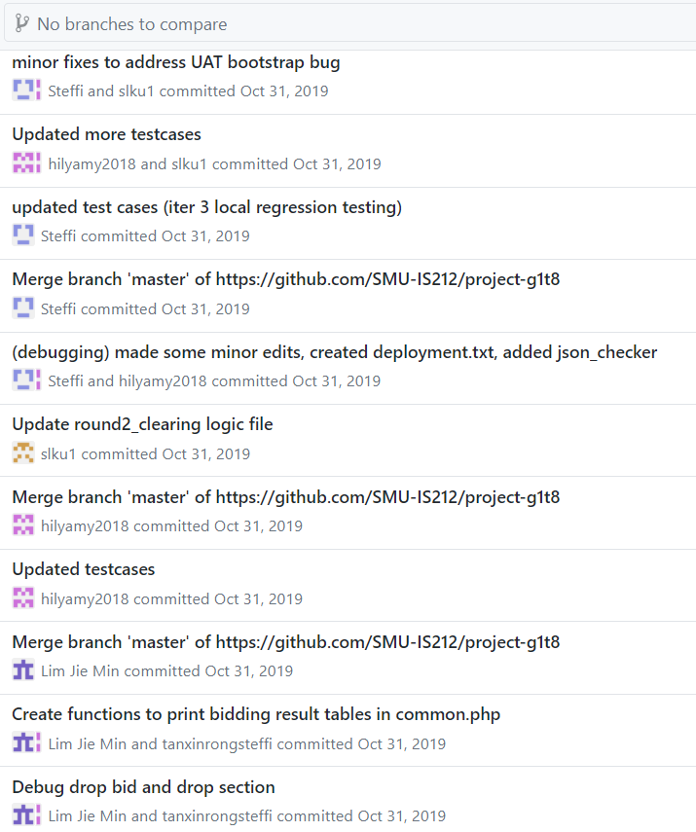
Commit Logs
Throughout the project, we made a point to have specific comments for our commits. This allowed us to glean was was previously done at a glance.

Slide 18
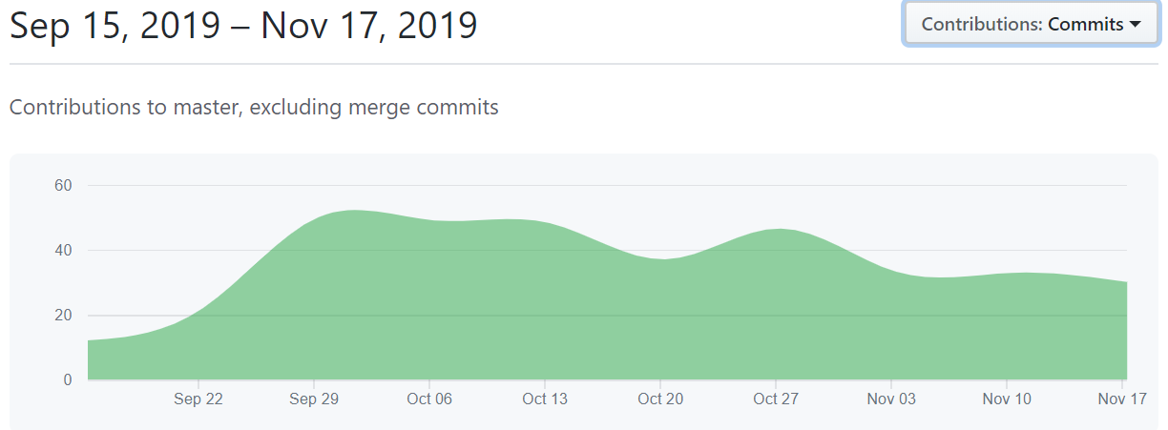
Overall frequency of commits from GitHub Insights

Slide 19
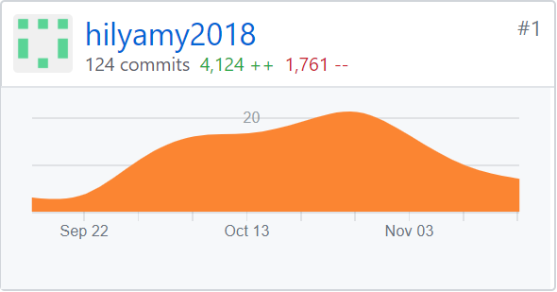
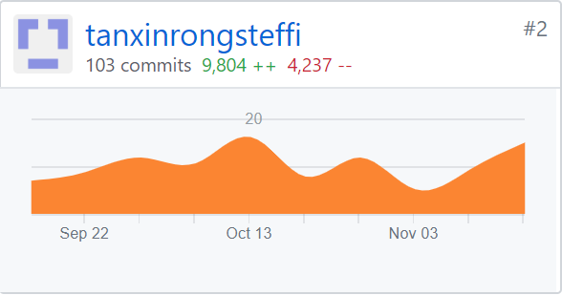
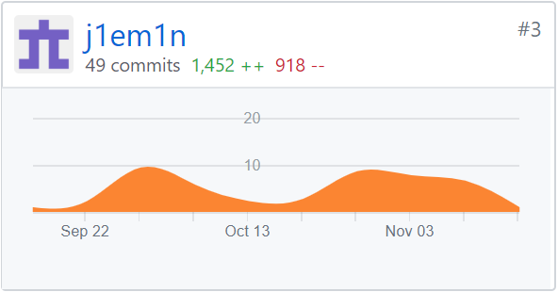
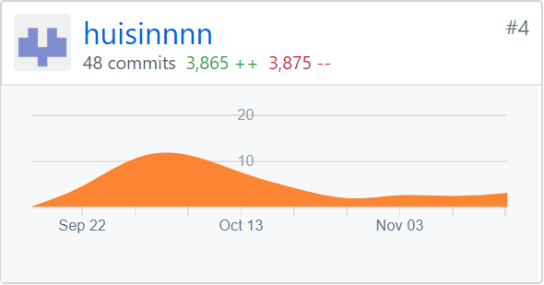
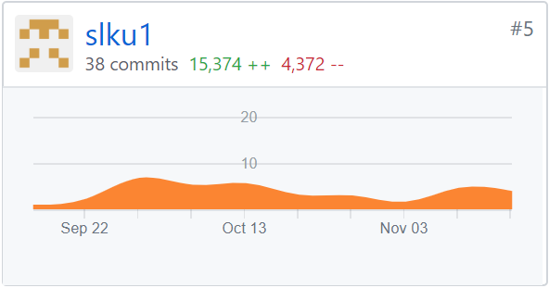
Commits
From the graphs, each member’s number of commits seems to differ significantly. However, this is due to different commit practices that we failed to standardise as a team.

Slide 20
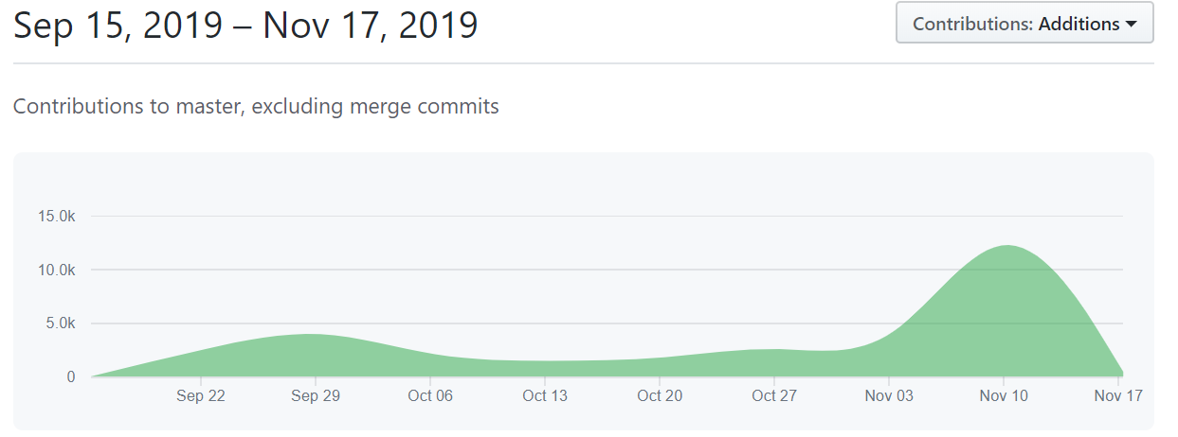
Overall contributions (additions) from GitHub Insights

Slide 21
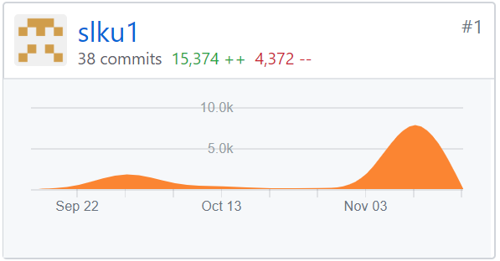
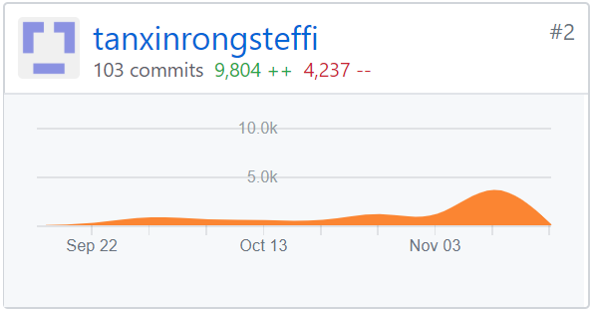
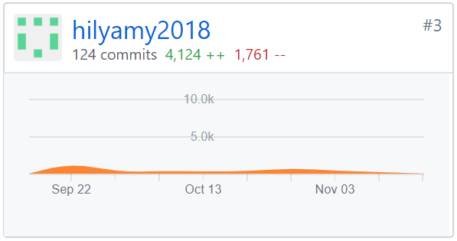
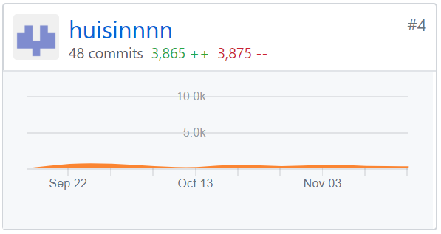
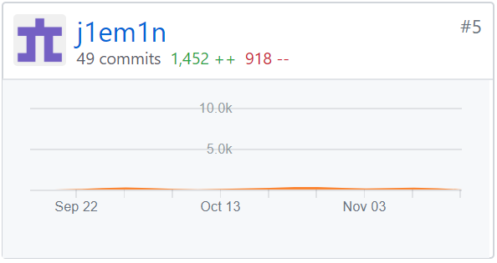
Additions
The statistics for ‘additions’ balances out the disparities in frequency of commits. Some members have a habit of committing one file at a time, while others commit a few at once.

Slide 22
Main Takeaways

Slide 23
Main Takeaways
Be agile and adaptable | Switch programming pairs to optimize abilities even if original planned pairing was different
Plan for contingencies | Try not to get chickenpox, but if it happens, we’ll cover for you
Understand and clarify what clients want | Read, reread, and re-reread the project wiki and discussion forum plus spam Rajesh and Co. with a ton of questions

Slide 24
G1T8 -
Let’s Git it!

Slide 25
Team conflicts / issues / problems
Certain members of our team are not highly proficient in programming. At the start of the project, we initially scheduled them to be pair programmers for Iteration 3, but had to switch their teams and pair each of them up with a stronger programmer.
During the first couple of iterations, we had a habit of not communicating with each other before making commits, resulting in us having to deal with merge conflicts.

Slide 26

Interesting Facts
Something particularly interesting about your team members that you did not know before SPM.
Steffi is a genius, not surprising if she’s the next Einstein; a goddess coder
Hilya and Hui Sin are very similar: 1. not only do their names both start with ‘H’, 2. they’re awesome programmers, and 3. they both had major dental episodes in the course of the project
Sky is devoted to his gf, and they're both really cute
Jie Min is 3 years older than Sky?!

